Slide 1
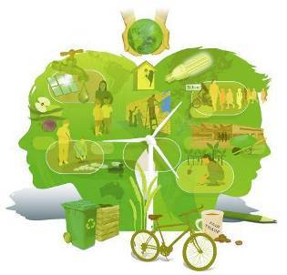
Strategy, aims, and principles of sustainable development

Slide 2
PLAN
1.Definition of Sustainable Development
2. Main factors of triune concept sustainable development
3. Strategy of sustainable Development
4. The principles of sustainable development

Slide 3
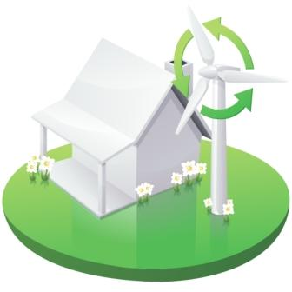
What is SUSTAINABLE DEVELOPMENT?
Development that meets the needs of the present without compromising the ability of the future generations to meet their own needs

Slide 4
SUSTAINABLE DEVELOPMENT
Balancing the fulfillment of human needs with the protection of the natural environment so that these needs can be meet not only in the present, but in the indefinite future

Slide 5
Meeting such needs “without undermining the ability of future generations to meet their own needs” means:

Slide 6
What to do?
Minimizing use or waste of non-renewable resources (by minimizing the consumption of fossil fuels and substituting with renewable sources where feasible)
Minimizing the waste (by reducing use, reusing, and recycling).

Slide 7
What to do?
Sustainable use of renewable resources (by using freshwater, soils, and forests in ways that ensure a natural rate of recharge)

Slide 8
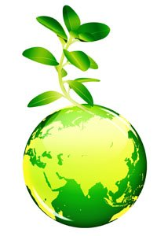
The words and concept of Sustainable Development was first used by Gru Harlem Brutland In 1987, in the his report Our Common Future the World Commission on Environment and Development (WCED) gave special consideration to the necessity of sustainable development, at which meeting the needs and requirements of the current times does not destruct the ability of future generations to satisfy their own needs.

Slide 9


At the conference of the UN on the environment and development in Rio de Janeiro (1992) a detailed analysis of the environment situation in the world was presented. Heads of states and governments took part in the conference, and adapted first Concept of Sustainable Development .
United Nations

Slide 10
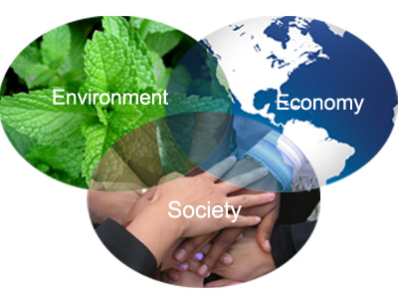
However, the results of the decade passed after the UN Conference in Rio de Janeiro certified that the problem of implementing the model of sustainable development was much more complicated that it had been supposed in the past and in 2002 was adapted a new triune concept of sustainable (ecological and social and economic) development

Slide 11
economic
Main factors of triune concept sustainable development
social
ecological

Slide 12
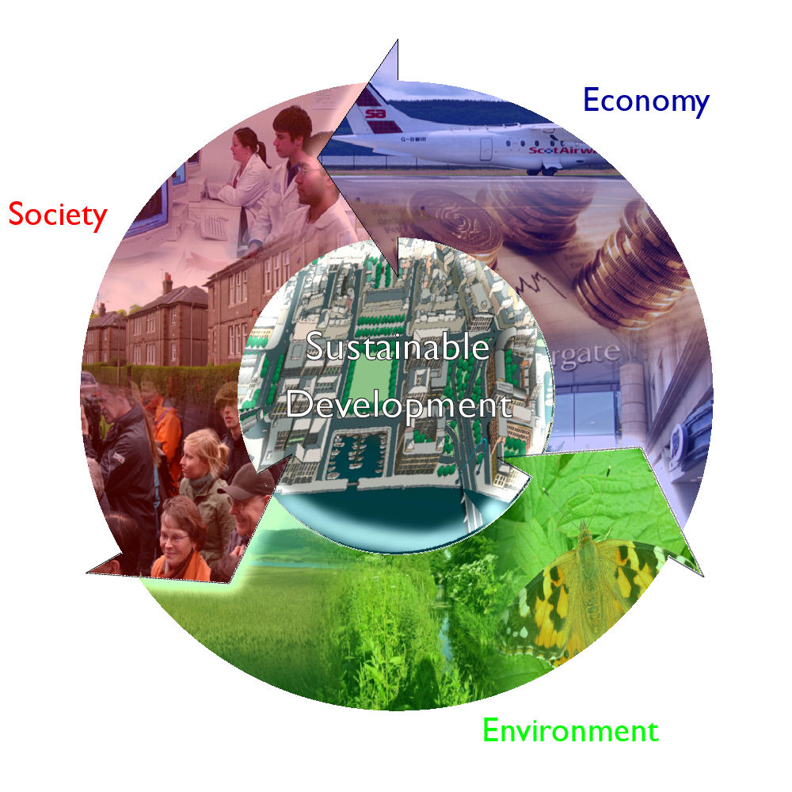

Slide 13
An economic component implies optimal use of natural resources and environmentally friendly technologies, including production and processing raw materials, manufacturing environmentally acceptable products, minimization, processing, waste management, waste destruction.

Slide 14
Economic
Services
Household needs
Industrial growth
Agricultural growth
Efficient use of labor
An economically sustainable system must be able to produce goods and services on a continuing basis, to maintain manageable
levels of government and external debt, and to avoid extreme sectoral imbalances which damage agricultural or industrial production.

Slide 15
A social component of sustainable development is directed to a human being and aimed at maintaining stability of social and cultural systems, including reduction and mitigation of the number of destructive conflicts amongst people. An important aspect of this approach is a fair distribution of benefits.

Slide 16
Social
Equity
Participation
Empowerment
Social mobility
Cultural preservation
A socially sustainable system must achieve fairness in distribution and opportunity, adequate provision of social services including health and education, gender equity, and political accountability and participation.

Slide 17
An ecological component must provide the integrity of biological and physical nature system. Degradation of natural resources, pollution of the environment and loss of biological diversity reduces the capacity of ecological systems to self-restoring

Slide 18
Environmental
Biodiversity
Natural resources
Carrying capacity
Ecosystem integrity
Clean air and water
An environmentally sustainable system must maintain a stable resource base, avoiding over-exploitation of renewable resource systems ,and depleting nonrenewable resources. This includes maintenance of biodiversity, atmospheric stability, and other ecosystem functions not ordinarily classed as economic resources.

Slide 19
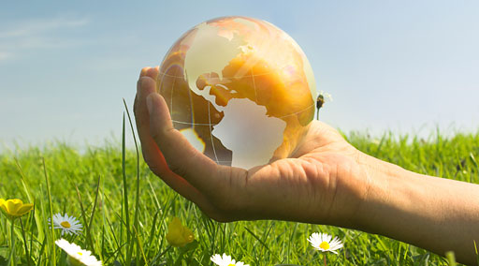
Coordination of these factors of sustainable development and translating them into specific measures which are the means of achieving sustainable development is a very complicated task, because all three elements of sustainable development must be viewed in a balanced way.

Slide 20
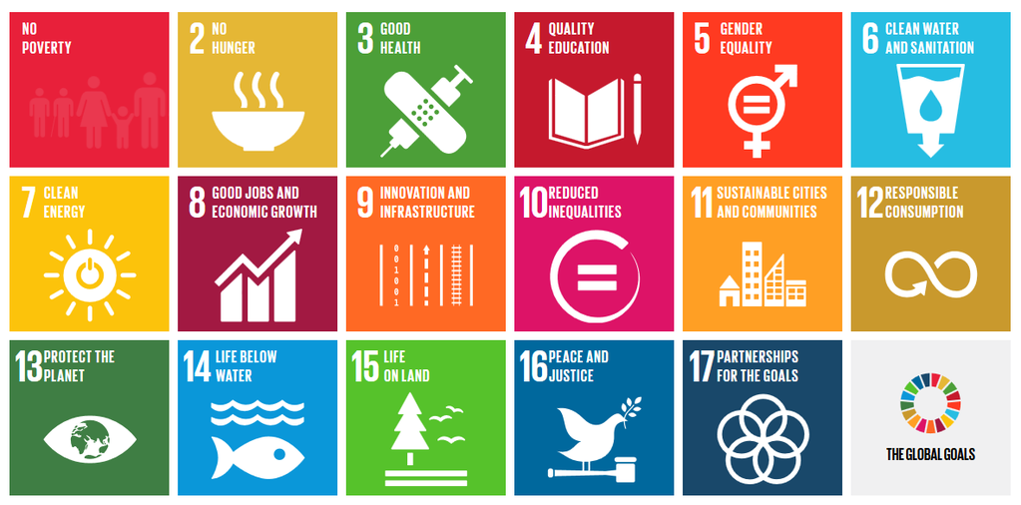
Strategy, goals and principle of SD
Securing economic development, social equity and justice, and environmental protection is the goal of sustainable development.

Slide 21
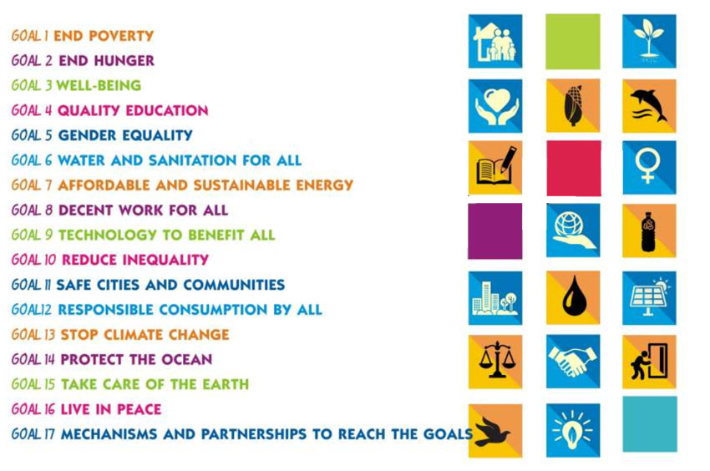
There are 17 goals principles of sustainable development

Slide 22
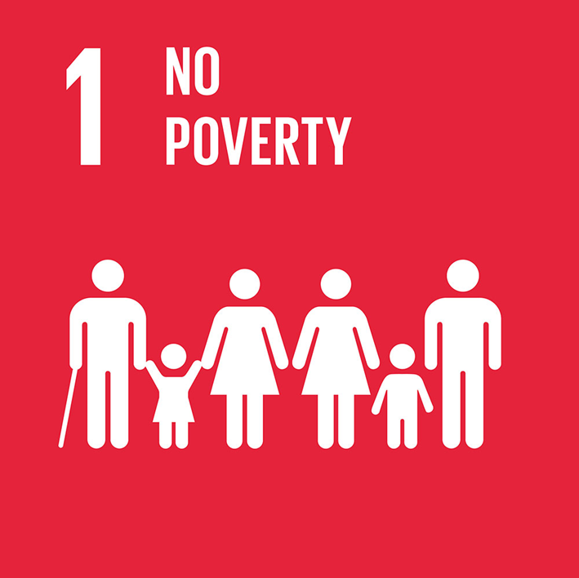
End Poverty in all its forms Everywhere

Slide 23
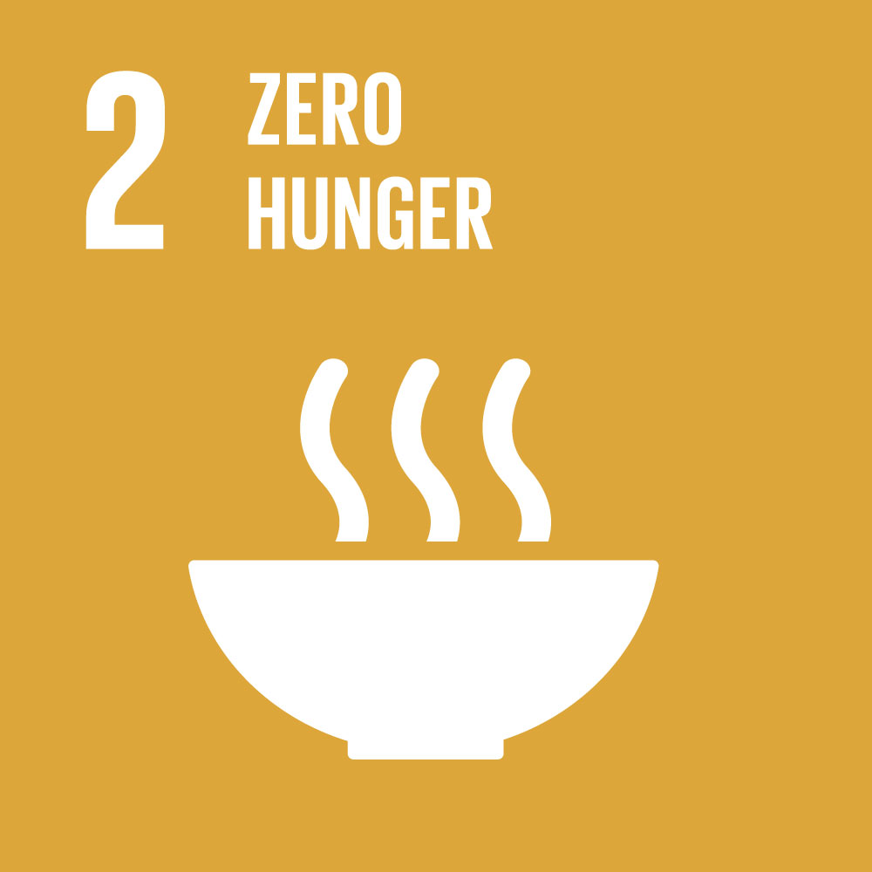
End hunger, achieve food security and improved nutrition and promote sustainable agriculture

Slide 24

Ensure healthy lives and promote well-being for all at all ages

Slide 25

Ensure inclusive and quality education for all and promote lifelong learning

Slide 26
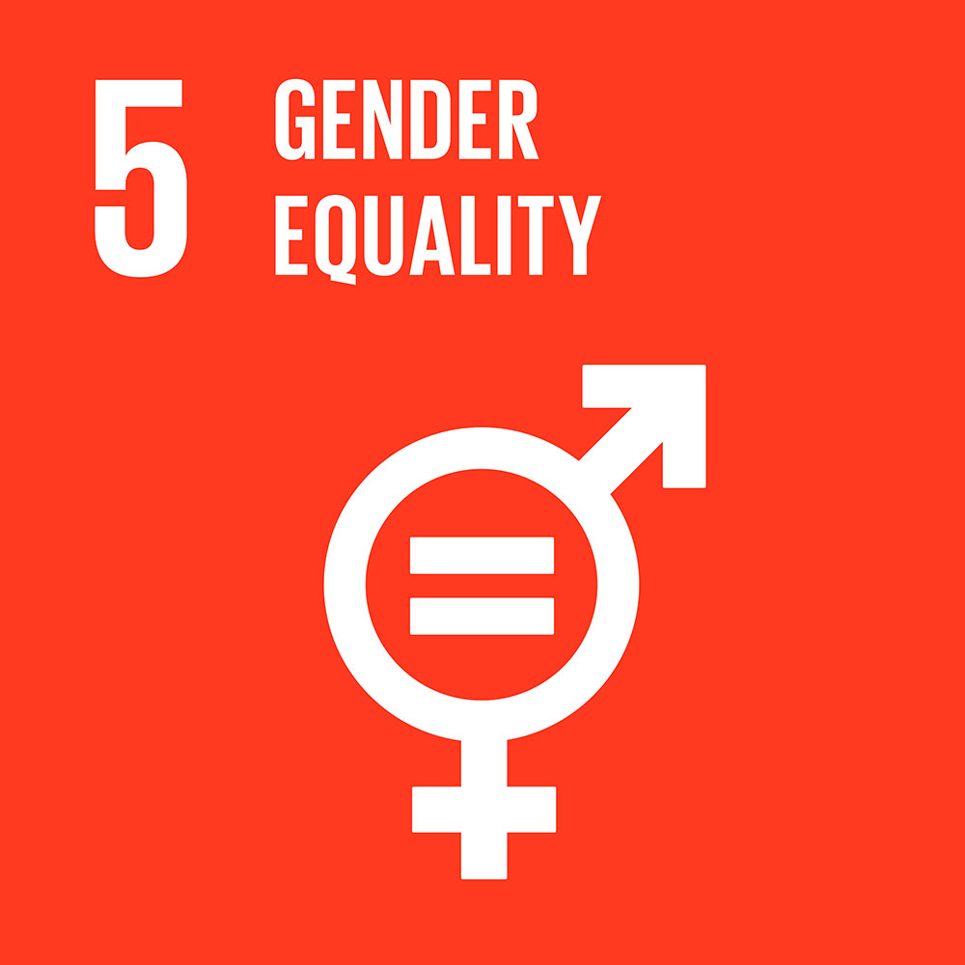
Achieve gender equality and empower
all women and girls

Slide 27

Ensure access to water and sanitation for all

Slide 28
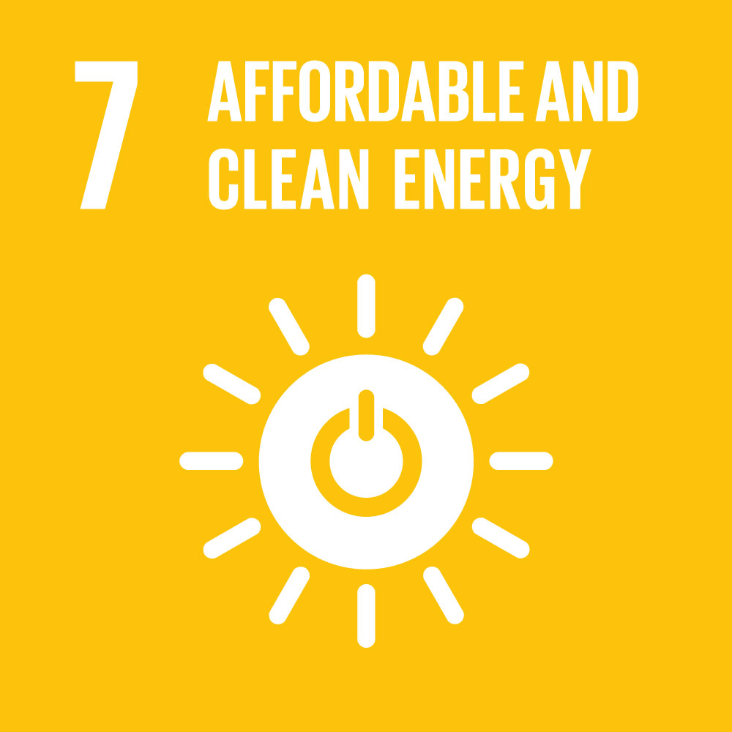
Ensure access to affordable, reliable, sustainable and modern energy for all

Slide 29
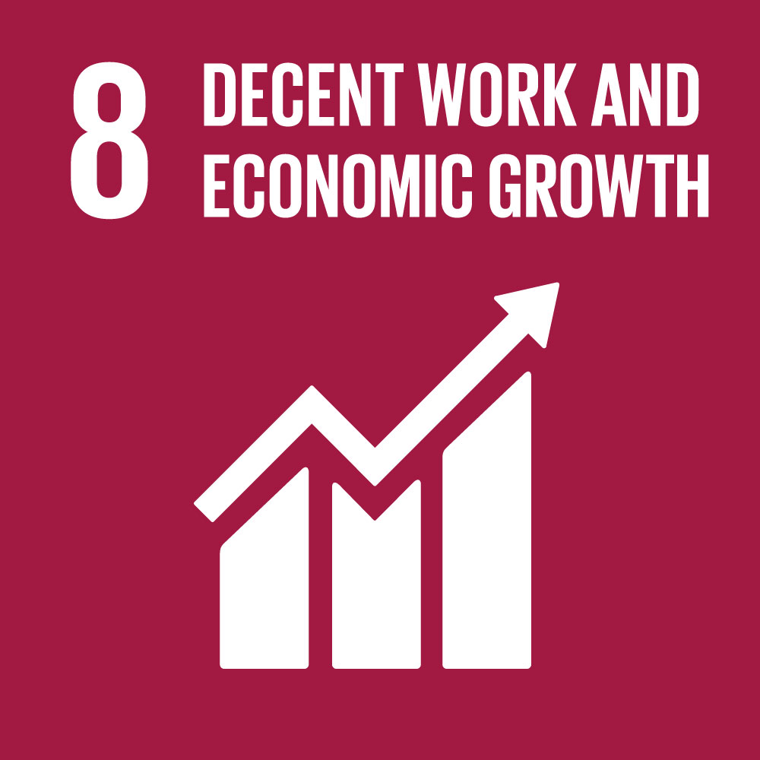
Promote inclusive and sustainable economic growth, employment and decent work for all

Slide 30
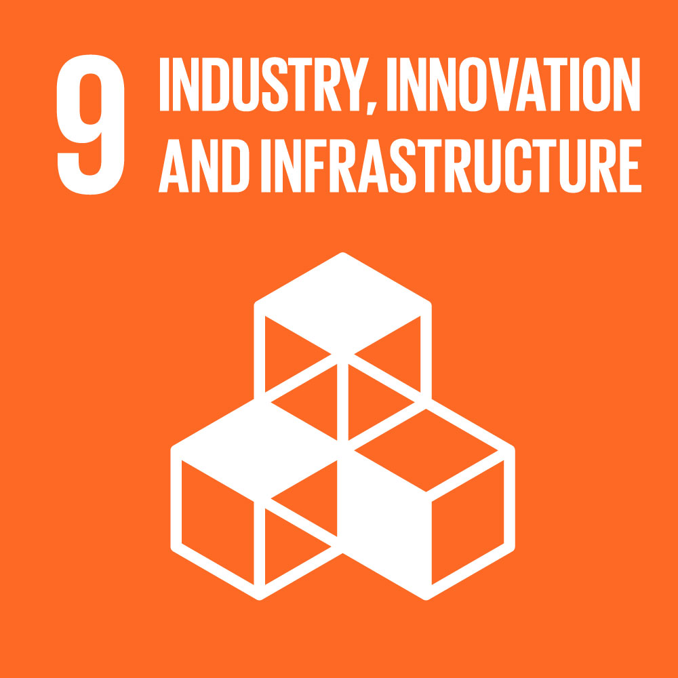
Build resilient infrastructure, promote sustainable industrialization and foster innovation

Slide 31
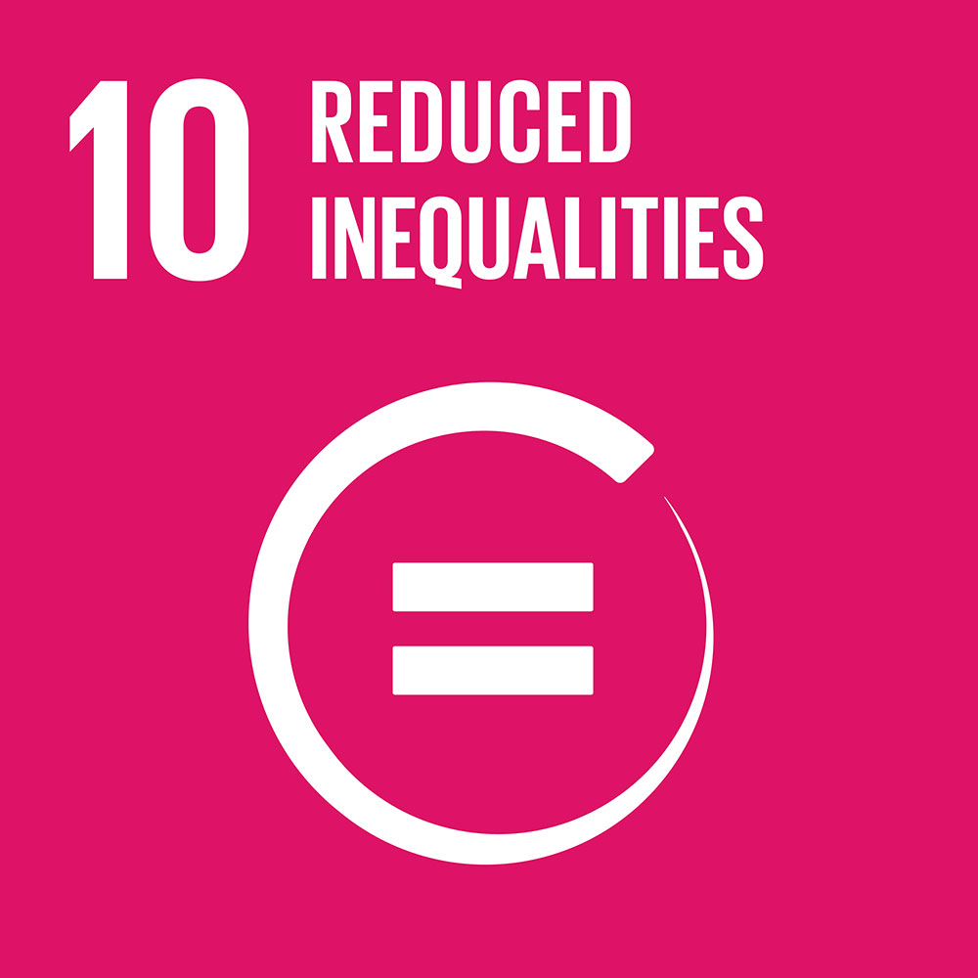
Reduce inequality within and
among countries

Slide 32
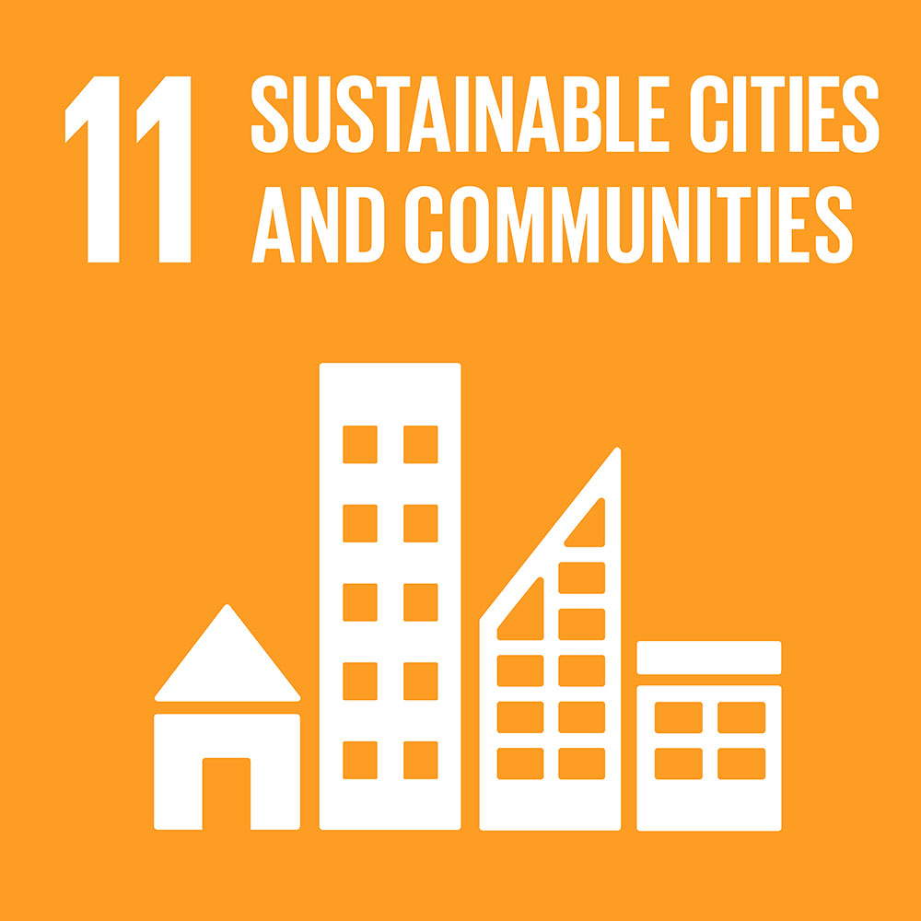
Make cities inclusive, safe, resilient
and sustainable

Slide 33
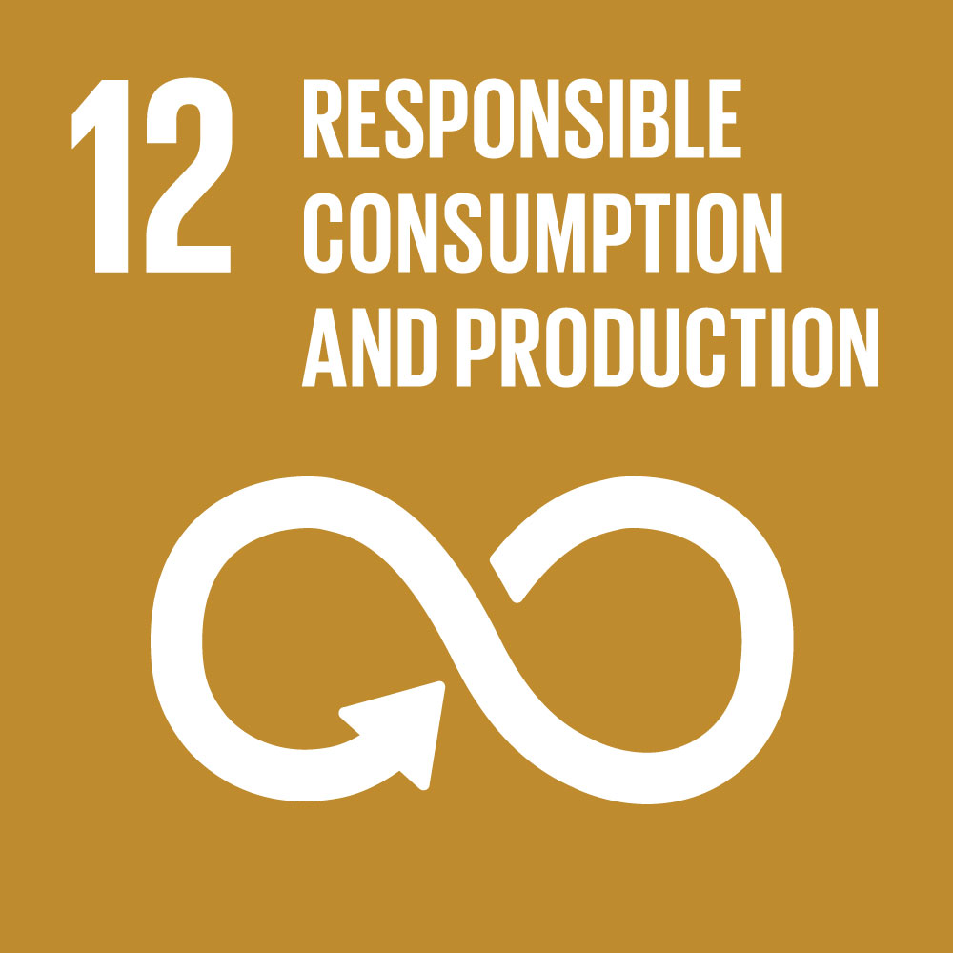
Ensure sustainable consumption and
production patterns

Slide 34
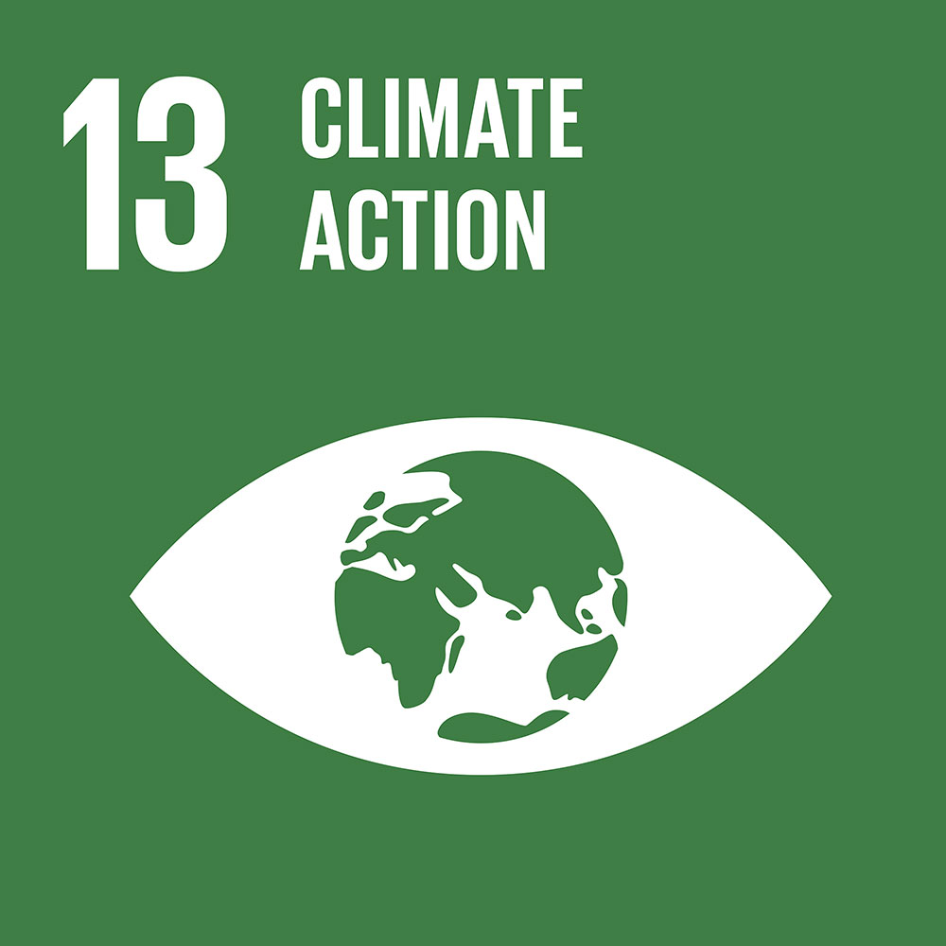
Take urgent action to combat climate change and its impacts

Slide 35
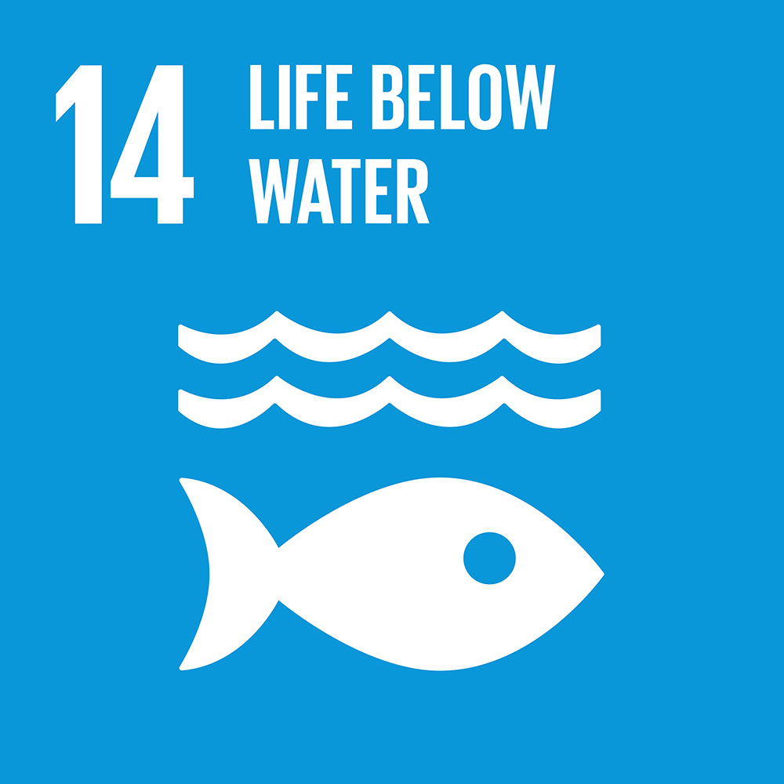
Conserve and sustainably use the oceans, seas and marine resources

Slide 36
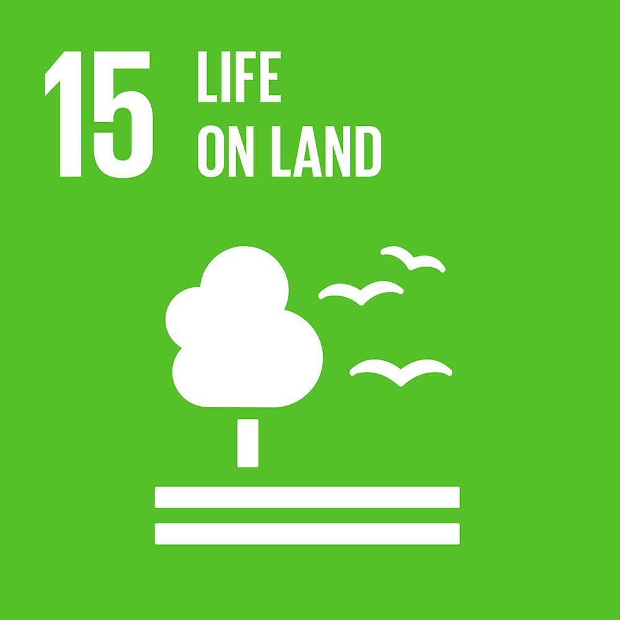
Sustainably manage forests, combat
desertification, halt and reverse land
degradation, halt biodiversity loss

Slide 37

Promote just, peaceful and inclusive societies

Slide 38
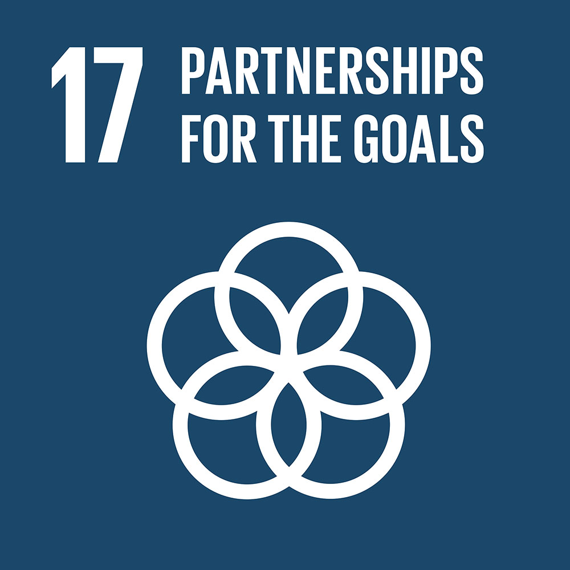
Revitalize the global partnership for sustainable development

Slide 39
Strategy of
sustainable Development
Sustainable Development Strategy as the idea of a new cultural paradigm emerged in the late twentieth century, thanks to the realization of the fact that the natural evolution of humanity has got in a difficult situation, which is characterized by the following:
- The allocation of resources is extremely uneven, which destabilizes the situation in individual countries (wealth-poverty), and in the world as a whole;
- The degradation of the natural environment, the biosphere leads to irreversible negative processes.

Slide 40
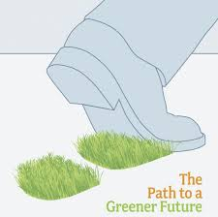
The strategy is based on the following guiding principles:
promotion and protection of fundamental rights,
solidarity within and between generations, the guarantee of an open and democratic society,
involvement of citizens, involvement of businesses and social partners,
policy coherence and governance, policy integration,
use of best available knowledge,
the precautionary principle and the polluter-pays principle.

Slide 41
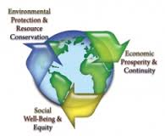
Principles of Sustainable Development
• People are entitled to a healthy and productive life in harmony with nature.
• Development today must not undermine the development and environment needs of present and future generations
• Nations shall warn one another of natural disasters or activities that may have harmful transboundary impacts.
• Peace, development and environmental protection are interdependent and indivisible.

Slide 42
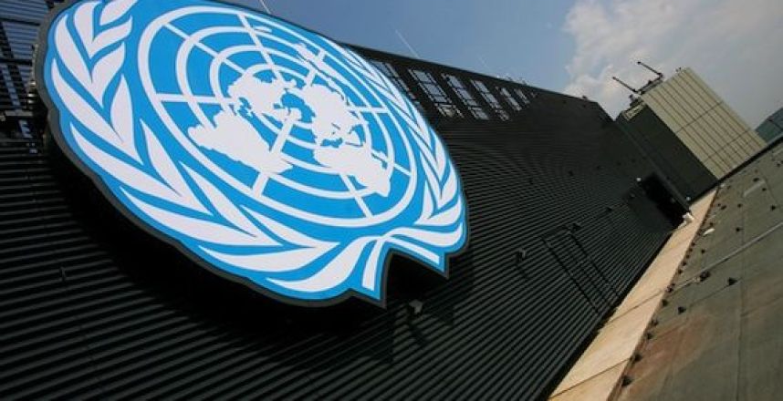
Principles
sustainable Development
Principle | Solution
The principle of a political solution to the ecological crisis | Problems relating to the environmental crisis should be solved by peaceful means, based on the goodwill of all members of the international community.

Slide 43
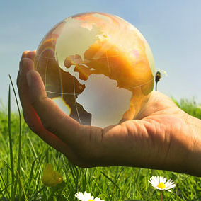
Principles
sustainable Development
Principles | Solution
The principle of greening all spheres of life | Resources of each territory are owned and used by its population, and are used to meet the basic material, spiritual, aesthetic needs, achieving sustainable development - it is the foundation of the greening of all spheres of life.

Slide 44

Thanks for Attention!

